Slide 1
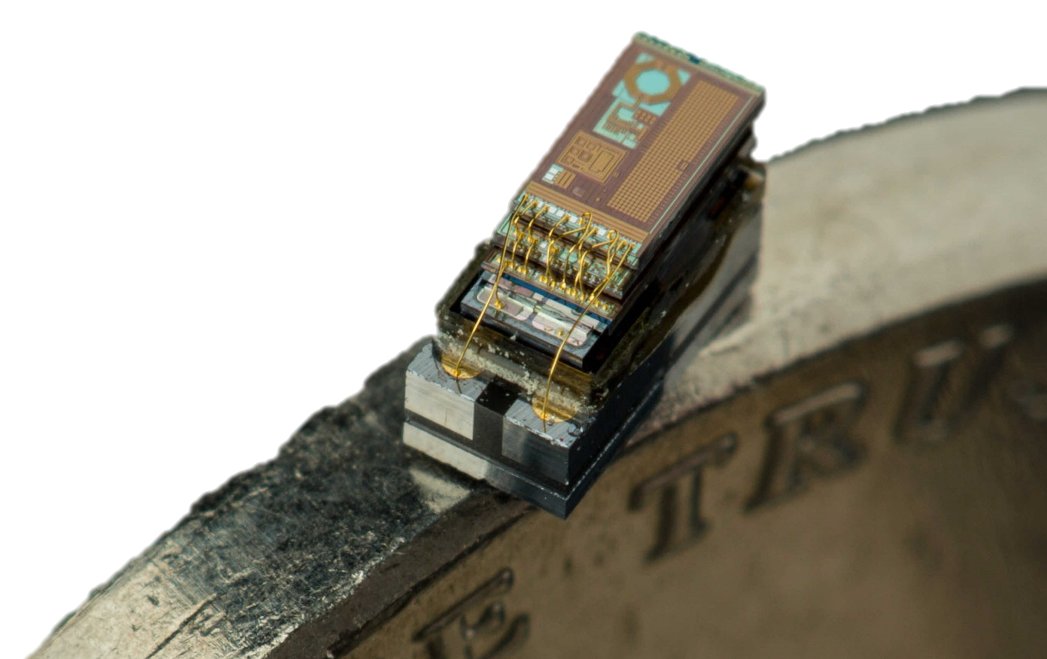
MBus An Ultra-Low Power Interconnect for Next Generation Nanopower Systems
Pat Pannuto, Yoonmung Lee, Ye-Sheng Kuo, ZhiYoong Foo, Benjamin Kempke, Gyouho Kim, Ronald G. Dreslinski, David Blaauw, and Prabal Dutta
University of Michigan
The 42nd International Symposium on Computer Architecture (ISCA’15)
June 13-17, Portland, Oregon, USA

Slide 2

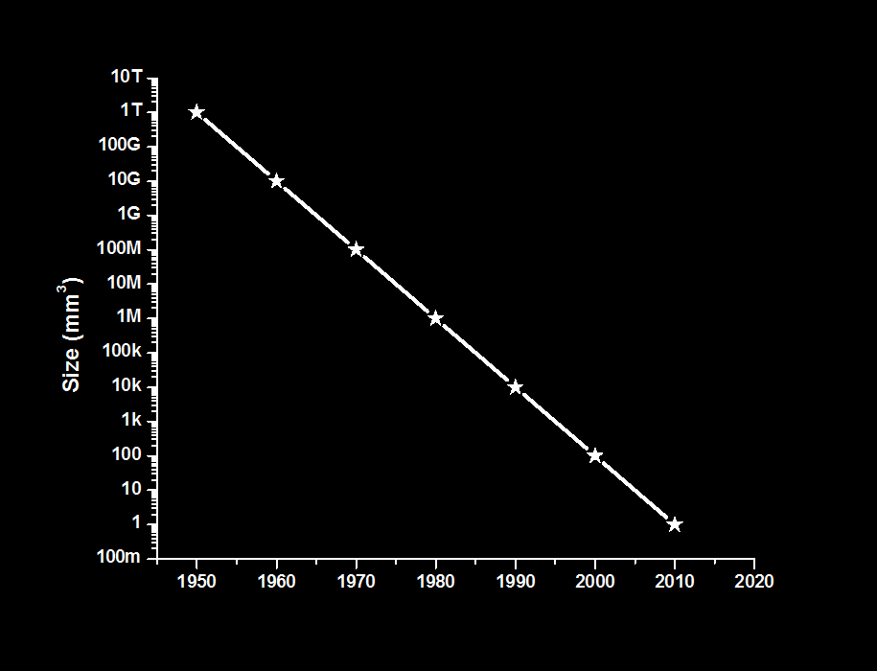
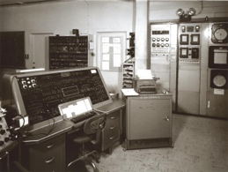
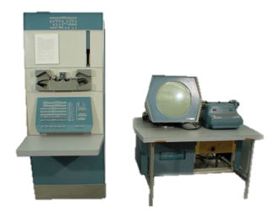


Bell’s Law: A new computing class every decade
Corollary:
100x smaller / decade
1 per Enterprise
1 per Engineer
Size (mm³)
Laptop
1 per Professional
“Smart Dust” should arrive by ~2017
1 per Company
1 per Family
1 per person
Graphic originally from Dennis Sylvester

Slide 3
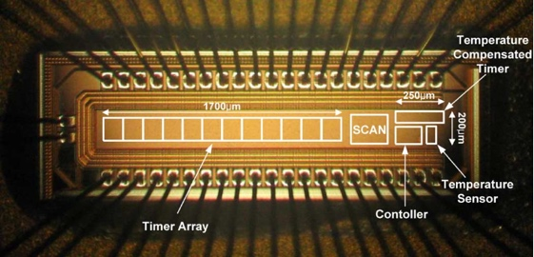
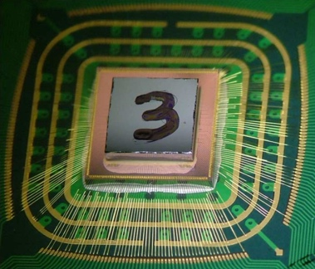
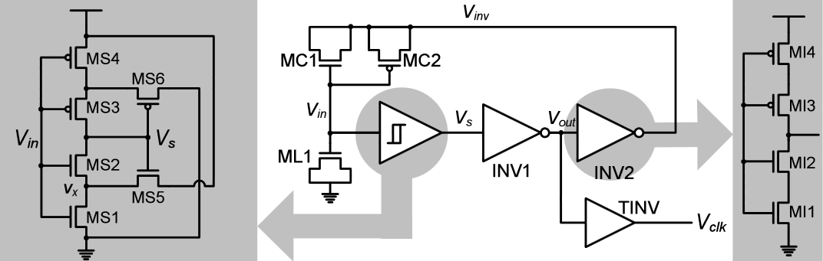
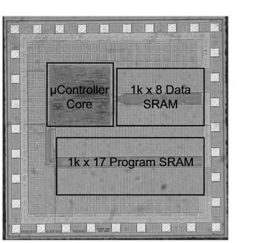
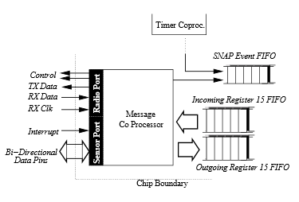
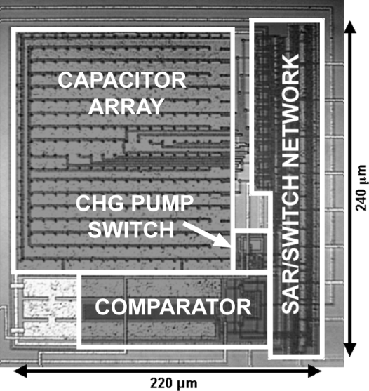
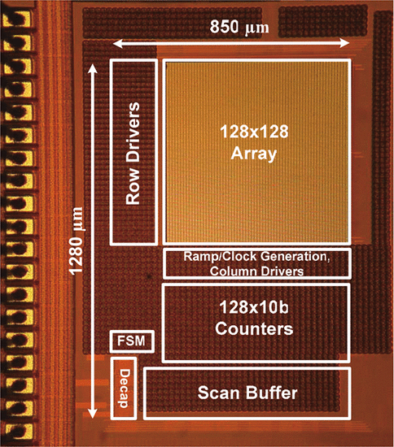
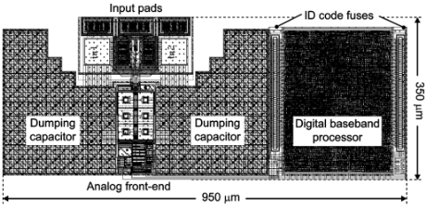
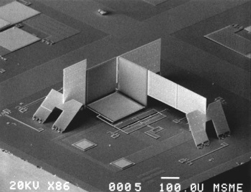
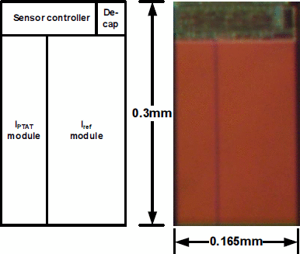
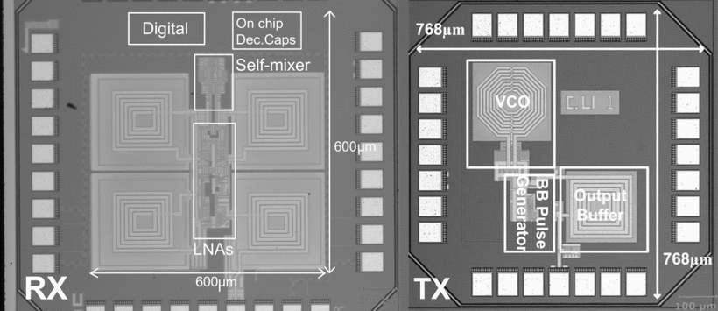
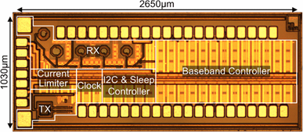
We have a diverse array of mm-scale components
Timers
Power Management
CPUs
Y.-S. Lin ‘07
Y. Lee ‘13
N. Sturcken ‘13
V. Ekanayake ‘04
ADCs and Sensors
Communication
B. Warneke ‘04
S. Hanson ‘09
A. Ricci ‘09
P. Chu ‘97
M. Scott ‘03
M. Crepaldi ‘10
J. Brown ‘13
Y.-S. Lin ‘08

Slide 4
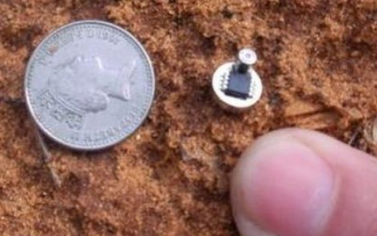
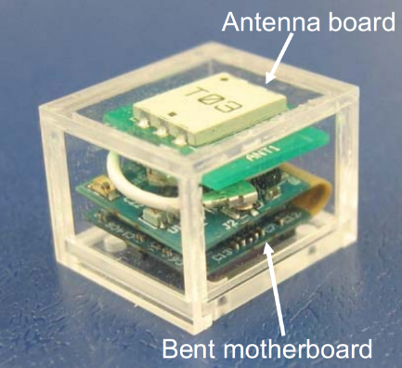
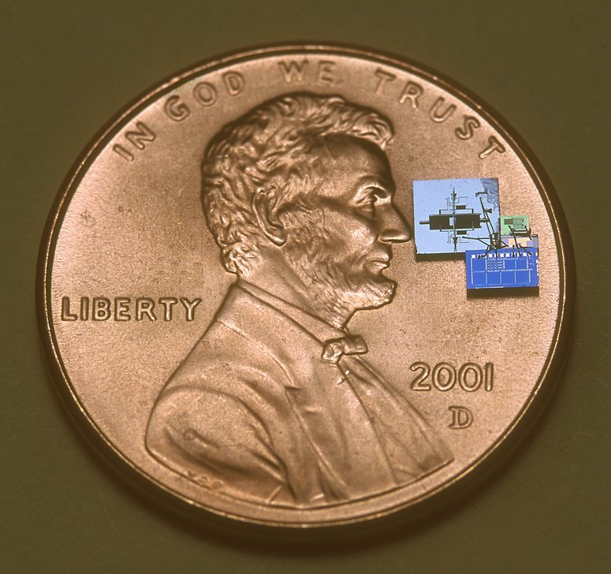
And a few mm-scale systems…
Smart Dew
The 1cc Computer
Smart Dust
Y. Shapira ‘08
T. Nakagawa ‘08
B. Warneke ‘07

Slide 5
But where is the next class of computing?
1 per Enterprise
1 per Engineer
Size (mm³)
Laptop
1 per Professional
?
1 per Company
1 per Family
100 – 1000’s per person
1 per person
Smartphone
Graphic originally from Dennis Sylvester

Slide 6
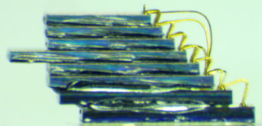
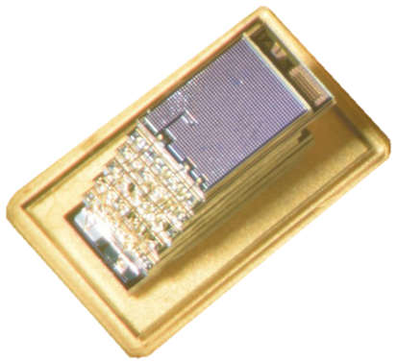
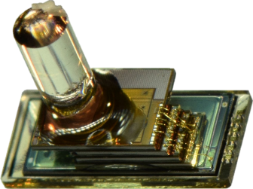
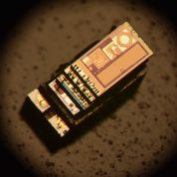
MBus is the missing interconnect that enables the mm-scale computing class
22.6 pJ / bit / chip, < 10 pW standby / chip
Single-ended (push-pull) logic
Low, fixed wire count (4)
Multi-master
Power-aware
Implemented in over a dozen (and growing) mm-scale chips
CPU, Radio
Flash Memory
Temperature, Pressure, Imager
To make half a dozen (and growing) mm-scale systems

Slide 7
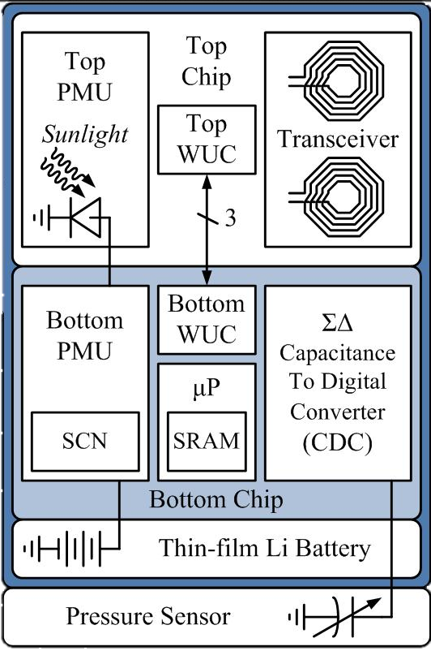
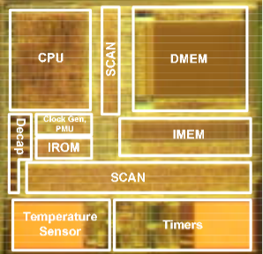
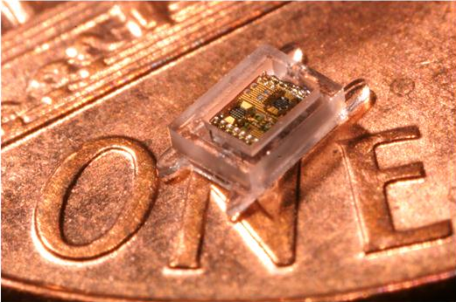
Modularity is key for fast, iterative design, but was previously absent from mm-scale systems
Phoenix 2008:
World’s lowest power computer
Basically a temperature sensor
Intraocular Pressure 2011:
Collaboration for glaucoma health
A pressure sensor
From mm-scale temperature sensor to mm-scale pressure sensor took 3 years
The Phoenix Processor: A 30pW Platform for Sensor Applications, Mingoo Seok, Scott Hanson, Yu-Shiang Lin, Zhiyoong Foo, Daeyeon Kim, Yoonmyung Lee, Nurrachman Liu, Dennis Sylvester, David Blaauw , VLSI ‘08
A Cubic-Millimeter Energy-Autonomous Wireless Intraocular Pressure Monitor, Gregory Chen, Hassan Ghaed, Razi-ul Haque, Michael Wieckowski, Yejoong Kim, Gyouho Kim, David Fick, Daeyeon Kim, Mingoo Seok, Kensall Wise, David Blaauw, Dennis Sylvester, ISSCC ‘11

Slide 8
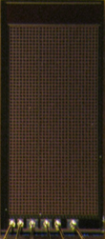
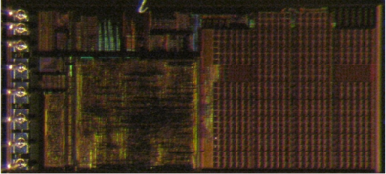
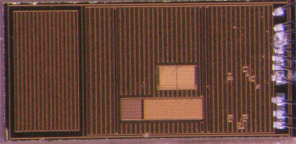
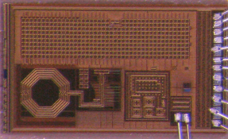
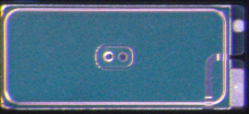
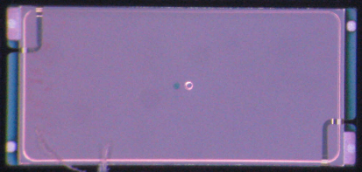

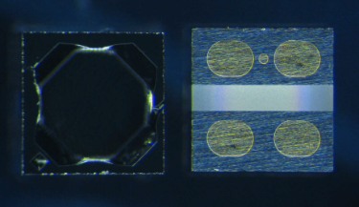
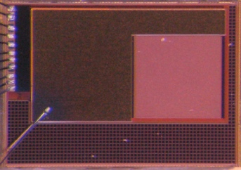
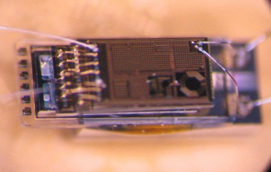
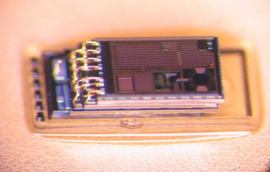
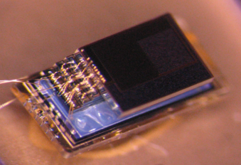
MBus enables a modular, composable ecosystem of mm-scale components
From temperature sensor to pressure sensor:
3 months.
Control/
PMU
Decap
Temp Sensor
Radio
+ CDC
2 uAh Battery
5 uAh Battery
MEMS
P. Sensor
Motion Detection/ Imager
Pressure Sensing
Temp. Sensing
Visual Sensing
Notes:
Modularity is one of the most important things in arch; when useful integrate. Currently mm-scale systems prematurely integrate due to artificial constraints

Slide 9
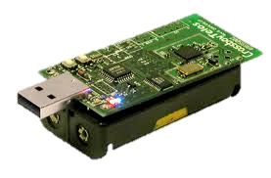
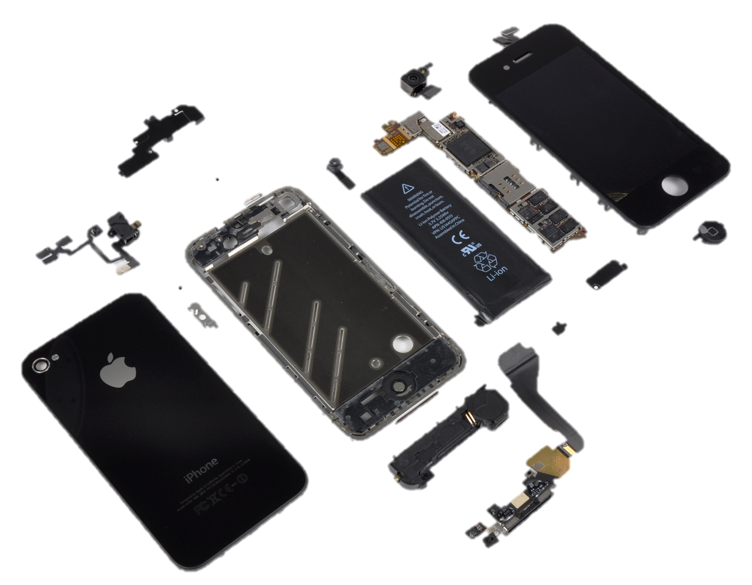
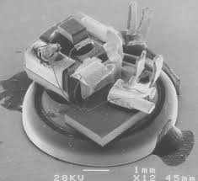
Existing interconnects have served us well for 30 years. What makes mm-scale systems unique?
Node volume is dominated by energy storage
And volume is shrinking cubically
“Phone”
Battery
“Sensor”
Batteries
“Sensor”
Battery
10’s μW active, 10’s nW sleep, DC 0.1%

Slide 10
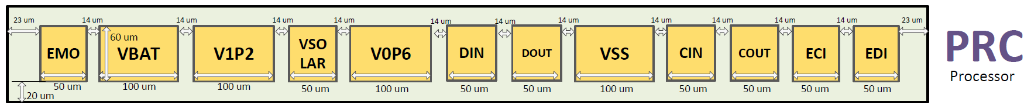
Existing interconnects have served us well for 30 years. What makes mm-scale systems unique?
Node volume is dominated by energy storage
And volume is shrinking cubically
I/O pads begin to account for non-trivial percentage of node surface area
“Phone”
Battery
“Sensor”
Batteries
1 mm = 1,000 μm
50 μm, minimum viable bond pad
“Sensor”
Battery
16-20 maximum I/O pins for 3D stacking
10’s μW active, 10’s nW sleep, DC 0.1%

Slide 11
SPI and I²C are like the USB and Firewire of embedded interconnects
Nearly every microcontroller has both
Nearly every peripheral has one or the other
Very few use anything else
(except maybe UART)

Slide 12
What is wrong with how are systems composed today?
SPI, invented by Motorola in ~1979
One master, N slaves
Shared clock: SCLK
Shared data bus: MOSI
Shared data bus: MISO
One Slave Select line per slave
Key Properties
One dedicated I/O line per slave
Master controls all communication
Master
Slave 1
SCLK
MOSI
MISO
SS0
SS1
…
SCLK
MOSI
MISO
SS
Slave 2
SCLK
MOSI
MISO
SS
Notes:
Extremely populare; almost all MCUs have this interface

Slide 13
What is wrong with how are systems composed today?
SPI, invented by Motorola in ~1979
One master, N slaves
Shared clock: SCLK
Shared data bus: MOSI
Shared data bus: MISO
One Slave Select line per slave
One interrupt line per slave
Key Properties
One Two dedicated I/O lines per slave
Master controls all communication
Interrupts must be out-of-band
Master
Slave 1
SCLK
MOSI
MISO
SS0
SS1
…
GPIO0
GPIO1
…
SCLK
MOSI
MISO
SS
INT
Slave 2
SCLK
MOSI
MISO
SS
INT

Slide 14
SPI’s I/O overhead and centralized architecture do not scale to mm-scale systems
SPI, invented by Motorola in ~1979
One master, N slaves
Shared clock: SCLK
Shared data bus: MOSI
Shared data bus: MISO
One Slave Select line per slave
One interrupt line per slave
Key Properties
One Two dedicated I/O lines per slave
Master controls all communication
Interrupts must be out-of-band
Master
Slave 1
SCK
MOSI
MISO
SS0
SS1
…
GPIO0
GPIO1
…
SCLK
MOSI
MISO
SS
INT
Slave 2
SCLK
MOSI
MISO
SS
INT

Slide 15
I²C has fixed I/O requirements and a decentralized architecture
I²C, invented by Phillips in 1982
Any-to-(m)any on one shared bus
Key Properties
Fixed wire count (2)
Node1
Node2
Node3
SCL
SDA
SCL
SDA
SCL
SDA

Slide 16
I²C has fixed I/O requirements and a decentralized architecture
I²C, invented by Phillips in 1982
Any-to-(m)any on one shared bus
Key Properties
Fixed wire count (2)
Open-collector
Multi-master
Flow Control
Node1
Node2
Node3
SCL
SDA
SCL
SDA
SCL
SDA
Open-collector (aka wired-AND)

Slide 17
The problem is the energy costs of running an open-collector
@400 kHz
V_{DD} = 1.2 V
No setup, no hold
R = 15.5 kΩ
(“the best”)
80% V_{DD} as 1
Send a “1”: 0 J
Send a “0”: 174 pJ

Slide 18

The problem is the energy costs of running an open-collector
@400 kHz
@400 kHz
V_{DD} = 1.2 V
No setup, no hold
Bigger R?
R = 15.5 kΩ
(“the best”)
80% V_{DD} as 1
Send a “1”: 0 J
Send a “0”: 174 pJ
SCL Alone: 70 μW

Slide 19
The problem is the energy costs of running an open-collector
@400 kHz
@400 kHz
V_{DD} = 1.2 V
No setup, no hold
Active Energy Budget: 20 μW
Not an arbitrary number:
Volume Target
Lifetime Target
R = 15.5 kΩ
(“the best”)
Two batteries
80% V_{DD} as 1
Send a “1”: 0 J
Send a “0”: 174 pJ
SCL Alone: 70 μW
~ 3.1 mm

Slide 20
The energy demands of open-collectors make them unsuitable for mm-scale systems
@400 kHz
Active Energy Budget: 20 μW
Not an arbitrary number:
Volume Target
Lifetime Target
Two batteries
SCL Alone: 70 μW
~ 3.1 mm
Notes:
Design for 20, try to hit 40 in practice

Slide 21
Can we modify I²C to bring energy costs in line with mm-scale?
Master
Slave1
Slave2
SCL
SDA
SCL
SDA
SCL
SDA

Slide 22
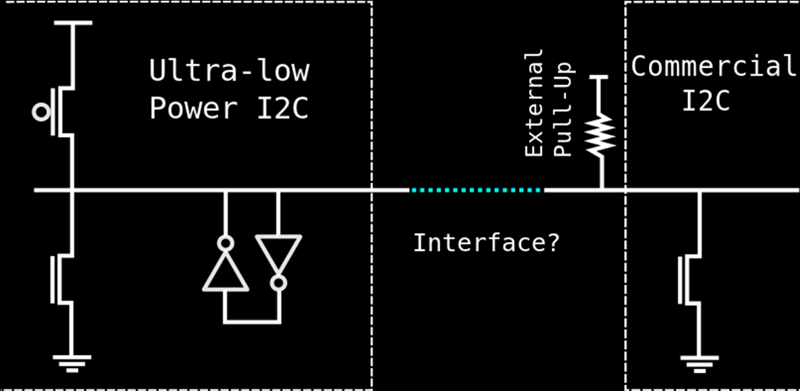
Replace the passive pull-up resistor with active circuitry
The Good : Able to achieve 88 pJ / bit (measured)
The Bad : Required clocks running at 5x bus clock on every chip
A Modular 1 mm³ Die-Stacked Sensing Platform with Low Power I2C Inter-die Communication and Multi-Modal Energy Harvesting
Yoonmyung Lee, Suyoung Bang, Inhee Lee, Yejoong Kim, Gyouho Kim, Mohammed Hassan Ghaed, Pat Pannuto, Prabal Dutta, Dennis Sylvester, David Blaauw
IEEE Journal of Solid-State Circuits

Slide 23
Replace the passive pull-up resistor with active circuitry
The Good : Able to achieve 88 pJ / bit (measured)
The Bad : Required clocks running at 5x bus clock on every chip
The Bad : “I²C-like” is not I²C – required FPGA to integrate with COTS chips
The Ugly : Hand-tuned, ratioed logic on every chip – Not synthesizable
Ultra-Constrained Sensor Platform Interfacing
Pat Pannuto, Yoonmyung Lee, Benjamin Kempke, Dennis Sylvester, David Blaauw, and Prabal Dutta
IPSN 2012 (Demo)

Slide 24
“Dark silicon” is more like “dimly lit silicon”
Clock-gated modules still exhibit static leakage
Blows mm-scale power budget
mm-scale systems perform power-gating
This means modules are cold-booting all the time
Manageable for monolithic designs because something always powered on
CPU
Radio
Timer
Sensor
Flash

Slide 25
Modular mm-scale components introduce novel circuits problems and novel systems problems
Clockless cold boot circuits are tricky
How do you know what’s awake?
How do you communicate with “pitch black” silicon to wake it up?
I²C-variant: custom “wakeup” signal
CPU
Radio
Timer
Sensor
Flash

Slide 26
The MBus design follows from a careful consideration of all the requirements for modular, mm-scale systems
Clock
Ring Topology
2 lines – 4 I/O per node
Clock
Data
“Shoot-Through”
MBus Mediator
Data
MBus Member
MBus Member
MBus Member
MBus Member
CLK_IN
CLK_OUT

Slide 27
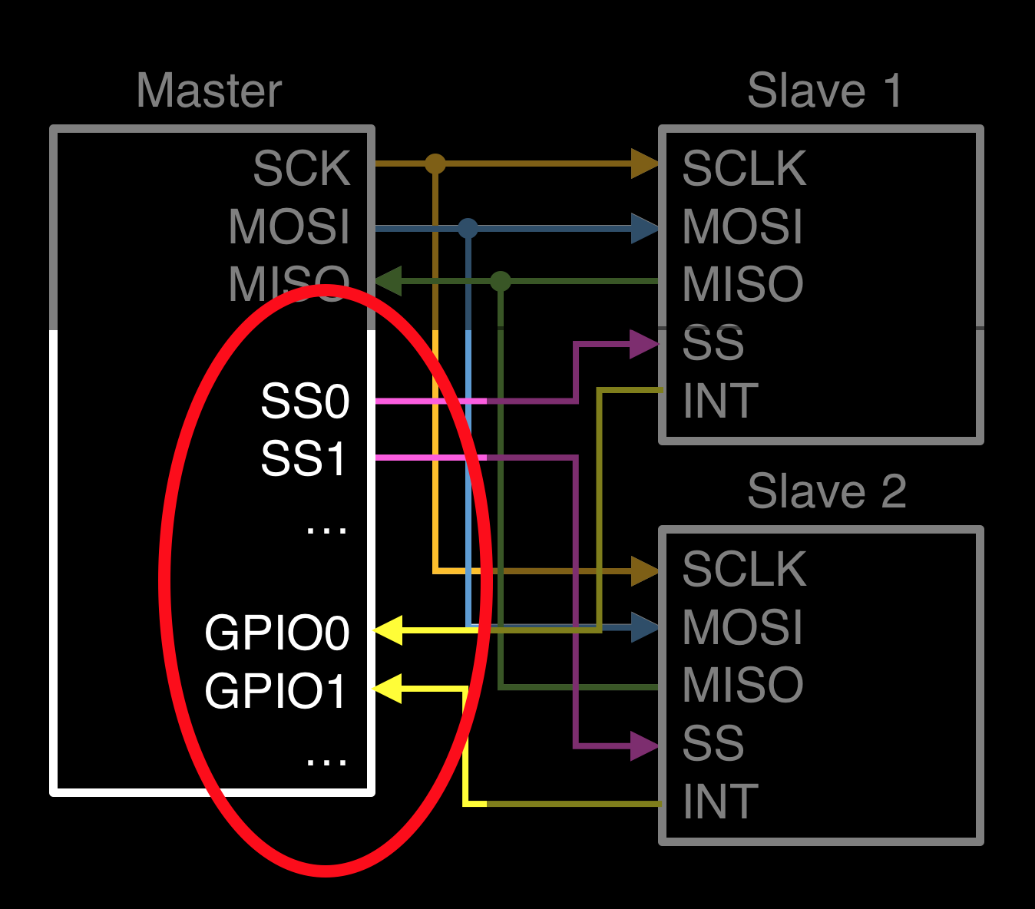
To be extensible and respect I/O constraints, wire count must be independent of node count
MBus Mediator
Clock
Recall SPI:
Data
MBus Member
MBus Member
MBus Member
MBus Member

Slide 28
Supporting interrupts with a fixed number of single-ended connections requires an arbitration protocol
Arbitrate
MBus Mediator
Clock
Recall: “shoot through”
C wants to send a message
Stop forwarding, drive 0
The mediator does not forward during arbitration
Also generates the bus clock
1
1
1
1
DATA_IN
0
1
1
DATA_OUT
D
A
Data
0
1
1
1
1
0
0
C
B
1
1

Slide 29
Supporting interrupts with a fixed number of single-ended connections requires an arbitration protocol
Arbitrate
MBus Mediator
Clock
Recall: “shoot through”
C wants to send a message
Stop forwarding, drive 0
The mediator does not forward during arbitration
Also generates the bus clock
0
0
1
1
0
1
1
DATA_IN
0
1
1
DATA_OUT
D
A
Data
0
1
0
0
1
1
1
0
C
B
1
0
1

Slide 30


Supporting interrupts with a fixed number of single-ended connections requires an arbitration protocol
Arbitrate
MBus Mediator
Clock
What changes if B tries to send as well as C?
B and C drive DATA_OUT to 0
B’s DATA_IN high, wins
C’s DATA_IN low, loses
MBus has topological priority
1
0
1
0
1
0
1
1
0
1
1
D
A
Data
0
1
0
0
1
1
1
0
C
B
0
0
1
0
1
Notes:
Transition: Now that we know who’s talking, how does the node declare who it’s talking to?

Slide 31
Tradeoff between globally unique addresses, address length, and overhead
Arbitrate
Address
Embed addresses in message frames
Overhead proportional to number of uniquely addressable device
I²C uses 7-bit device addresses with design-time LSBs
Requires I/O not available
Makes packaging assumptions
mm-scale systems not always PCB
Routing may not be easy
3D stack
Flip-chip + TSVs

Slide 32
Tradeoff between globally unique addresses, address length, and overhead
Arbitrate
Address
3 Options
Short static addresses and allow device conflicts
Long static addresses to avoid device conflicts
Non-static addresses
MBus does all 3
4-bit: Static short prefixes (device class)
24-bit: Static long prefixes (unique device ID)
4-bit: Runtime enumeration protocol (replaces short prefix)
Notes:
Mention broadcast messages orally

Slide 33
Unbounded messages maximize flexibility and minimize overhead
Arbitrate
Address
An MBus message is 0…N bytes of data
Embed length in message
Imposes large overhead for short messages
Forces fragmentation of long messages
“End-of-message” sentinel byte(s)
Imposes large overhead for short messages
Requires escaping if sentinel is in transmitted
Data-dependent behavior, hard to reason about
Worst case 2x overhead!
Data

Slide 34
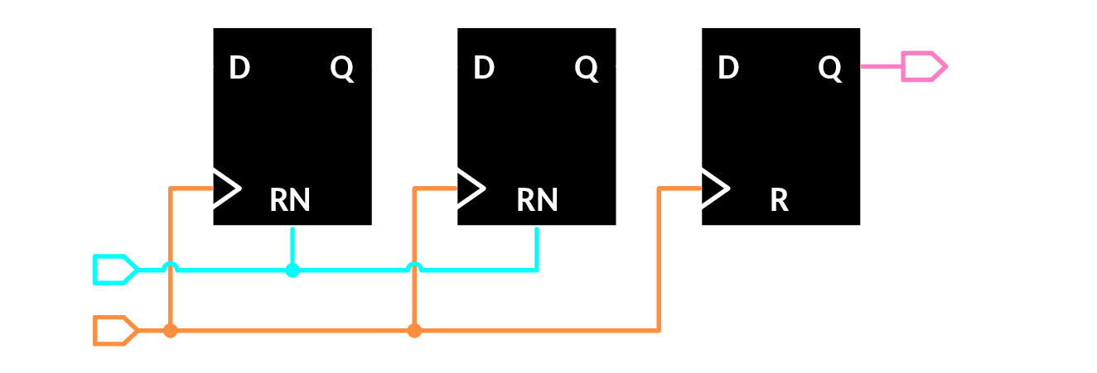
MBus “interjections” provide an in-band end-of-message with minimal overhead
Arbitrate
Address
During normal operation, Data toggles slower than Clock
Data
Clock
Data
Data
Interject

Slide 35
MBus “interjections” provide an in-band end-of-message with minimal overhead
Arbitrate
Address
During normal operation, Data toggles slower than Clock
Data
Clock
Data
Interject

Slide 36
MBus “interjections” provide an in-band end-of-message with minimal overhead
Arbitrate
Address
During normal operation, Data toggles slower than Clock
ACK
Data
Clock
Data
Interject
Idle
control

Slide 37
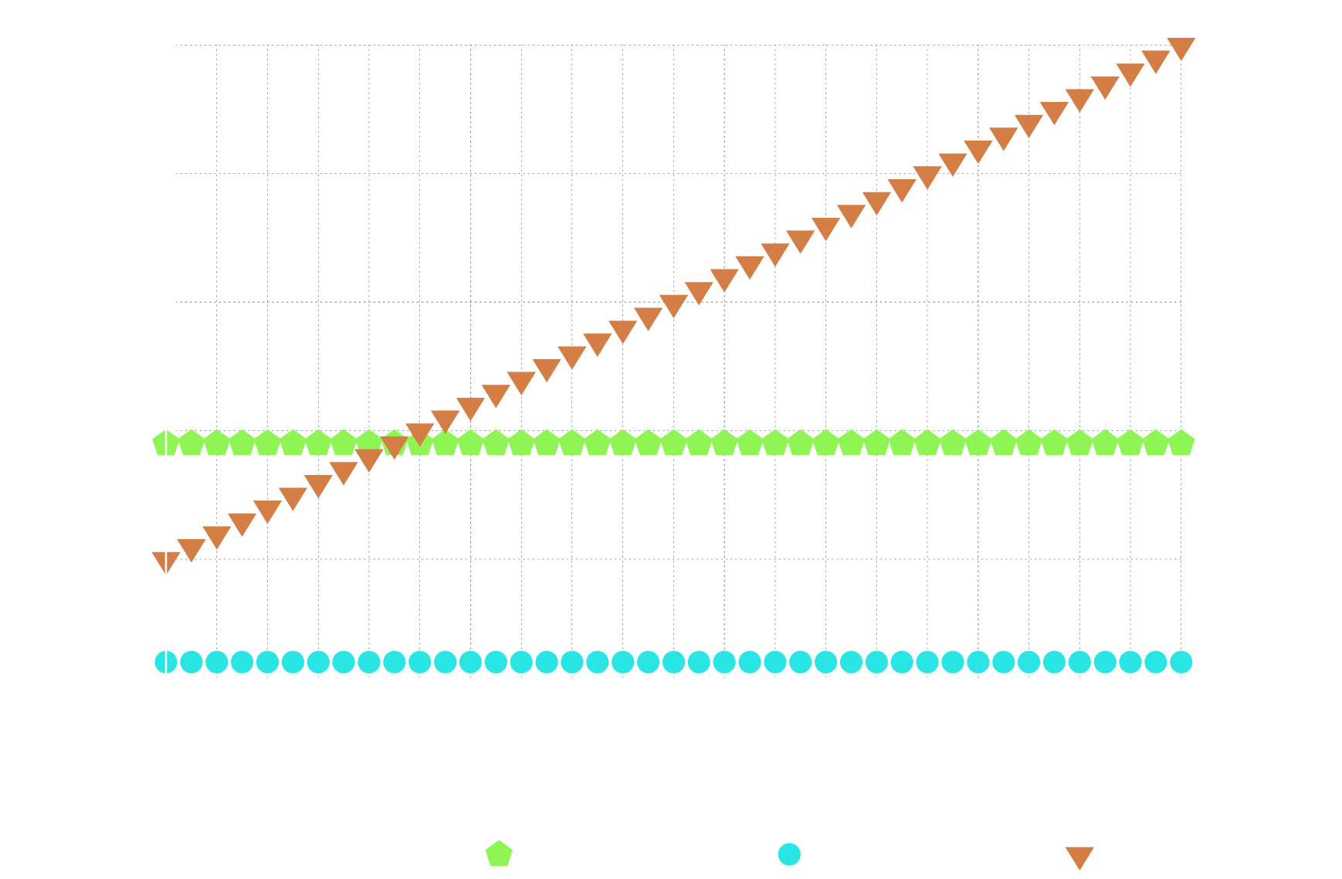
Transaction-level ACKs minimize common-case overhead while interjections preserve flow control
Arbitrate
Address
Data
9 bytes
Interject
Arbitration
+
Address
+
Interjection
control

Slide 38
The modularity enabled by MBus created a circuits problem and a systems problem
Arbitrate
Address
Clock
Clockless cold boot circuits are tricky
How do you communicate with “pitch black” silicon to wake it up?
How do you know what’s awake?
A power-gated node cannot send
Use arbitration edges to drive the cold-boot circuitry
(Minimal frontend: 35 gates, 4 regs)
Nodes awaken before addressing
Nodes appear to be “always on”
No need to know or track power states
MBus Mediator
Data
Data
MBus Member
MBus Member
Interject
CPU
Radio
Timer
Sensor
Flash
MBus Member
control

Slide 39
These primitives enable an architectural shift in system design
CPU acts as configurator instead of overseer
Preprogram temperature sensor to send radio packets
Not unlike modern SOCs (sleepwalking, μDMA), but distributed
Sensor
Sensor
CPU
CPU
Radio
Radio

Slide 40
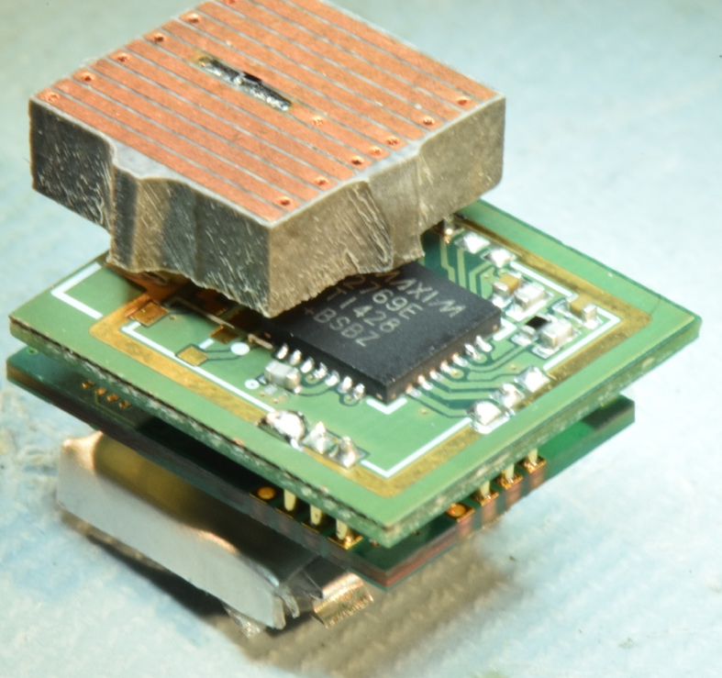
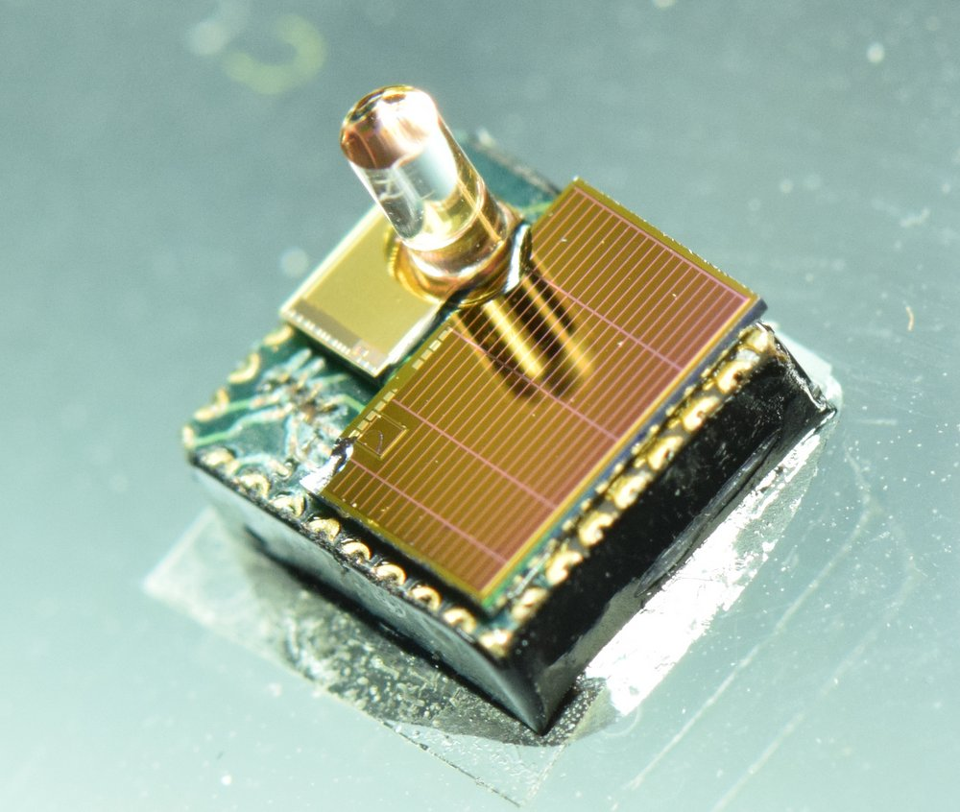
Seamless and transparent interaction between power-aware and power-oblivious chips
Facilitates integration with COTS chips
*No current COTS chip support MBus, these integrations leverage more traditional buses still

Slide 41
The majority of interconnect research is focused on performance at the expense of power and area
31.5 GB/s
5 Gb/s
115 b/s
22.8 MB/s
43.5 million times faster
1,381
times faster

Slide 42
Specification and Verilog at http://mbus.io
Control/
PMU
Decap
Temp Sensor
Radio
+ CDC
2 uAh Battery
5 uAh Battery
MEMS
P. Sensor
Motion Detection/ Imager
Pressure Sensing
Temp. Sensing
Visual Sensing

Slide 43
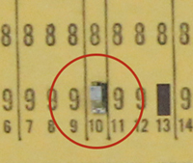
MBus-based smart dust now on display at the computer history museum

Slide 44
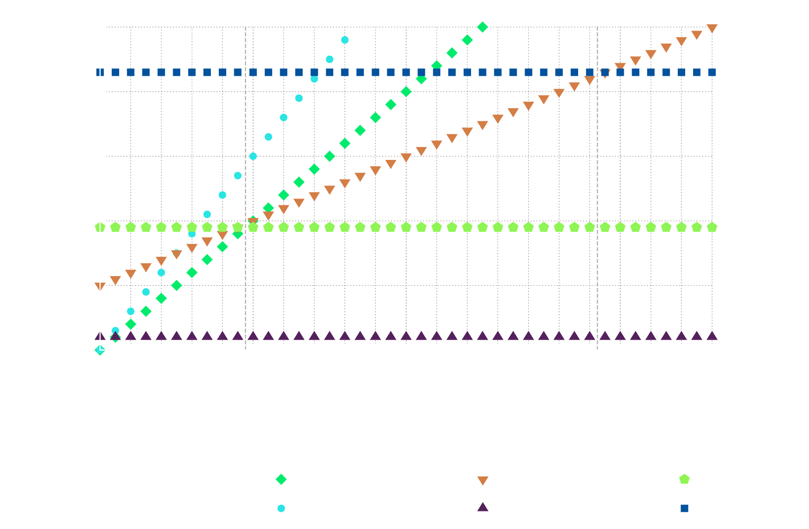
Protocol Overhead and message length

Slide 45
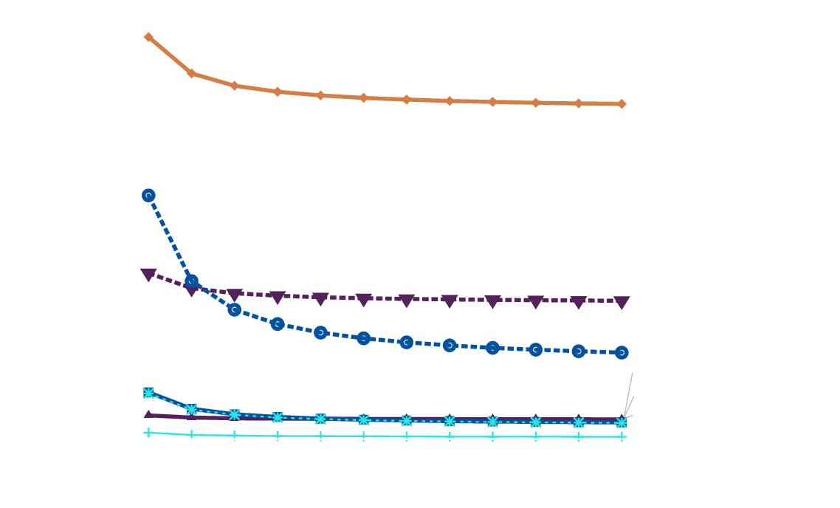
Energy per bit of goodput (useful data)

Slide 46

Power Draw Comparison

Slide 47

Goodput of parallel MBus

Slide 48

Saturating Transaction Rate

Slide 49

Adding additional nodes does not have significant impact on MBus latency
MBus Mediator
Clock
Recall: “shoot through”
Data
DATA_IN
DATA_OUT
MBus Member
1
1
MBus Member
MBus Member
10 ns
~7 MHz
10 ns
MBus Member

Slide 50
Some low-hanging fruit…
Full Duplex is trivial
“Selectively parallel”

Slide 51
Arbitration Detail

Slide 52
Interjection Detail

Slide 53
Tertiary node power-on request

Slide 54

Hierarchical Power Domains

Slide 55

Implementation

